Slide 1

MATHEMATICS
YEAR (2017 – 18)

Slide 2

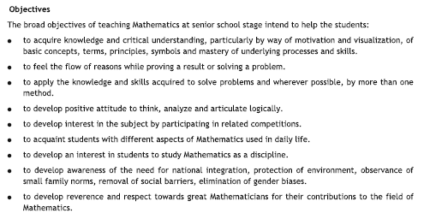
MATHEMATICS

Slide 3
MATHEMATICS
Units in class 11
Unit 1: Sets and Functions
Unit 2: Algebra
Unit 3: Coordinate Geometry
Unit 4: Calculus
Unit 5: Mathematical Reasoning
Unit 6: Statistic and Probability

Slide 4
MATHEMATICS

Slide 5
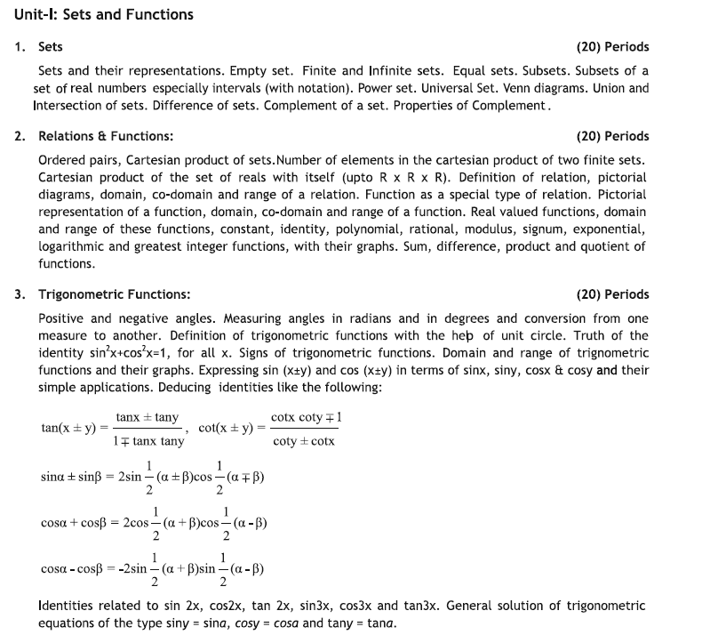
MATHEMATICS
Unit 1: Sets and Functions

Slide 6
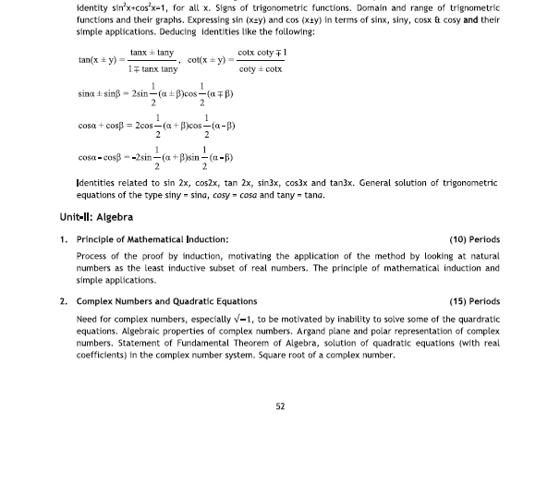
MATHEMATICS
Unit 2: Algebra

Slide 7
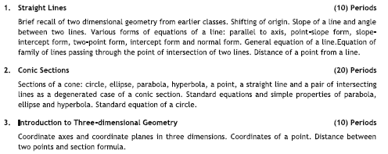
MATHEMATICS
Unit 3: Coordinate Geometry

Slide 8
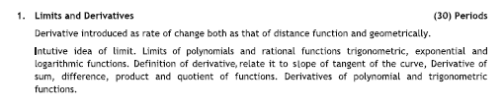
MATHEMATICS
Unit 4: Calculus

Slide 9

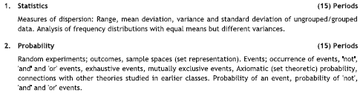
MATHEMATICS
Unit 5 & 6 : Mathematical Reasoning & Statistic and Probability

Slide 10
MATHEMATICS
Question wise Break up
Type of Question | Marks Per Question | Total no. Of Questions | Total Marks
VSA – 1 | 1 | 4 | 04
SA | 2 | 8 | 16
LA - 1 | 4 | 11 | 44
LSA – 2 | 6 | 6 | 36
Total |  | 29 | 100

Slide 11

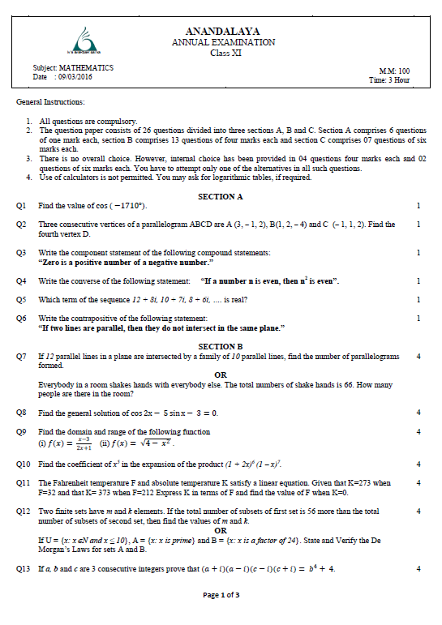
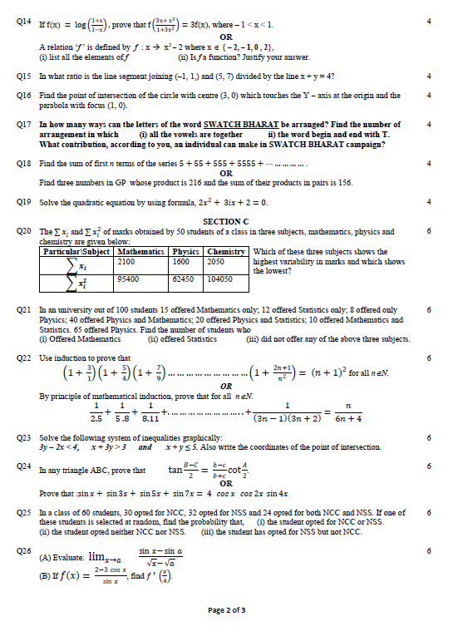
Last Year Paper of Annual Examination.

Slide 12
MATHEMATICS
Units in class 12
Unit 1: Relations and Functions
Unit 2: Algebra
Unit 3: Calculus
Unit 4: Vector and Three Dimension Geometry
Unit 5: Linear Programming
Unit 6: Probability

Slide 13
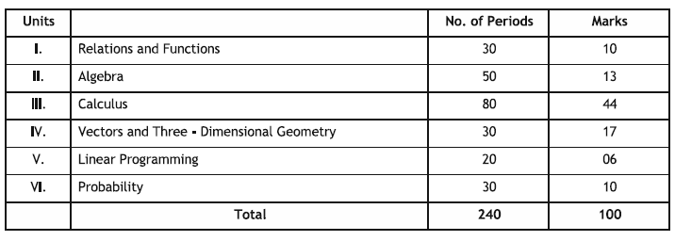
MATHEMATICS

Slide 14
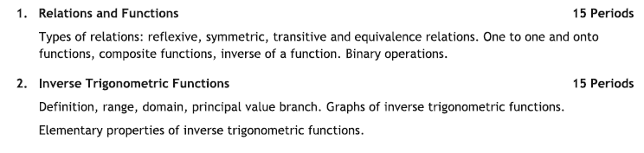
MATHEMATICS
Unit 1: Relations and Functions

Slide 15
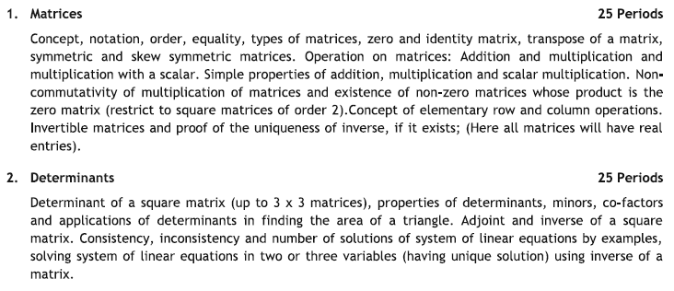
MATHEMATICS
Unit 2: Algebra

Slide 16
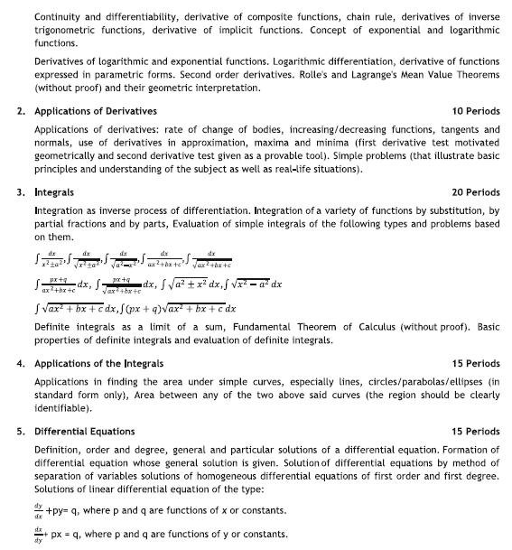
MATHEMATICS
Unit 3: Calculus

Slide 17
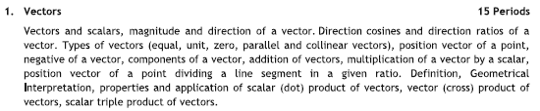

MATHEMATICS
Unit 4: Vector and 3 D Geometry

Slide 18


MATHEMATICS
Unit 5 & 6 : Linear Programming &Probability

Slide 19
MATHEMATICS
Question wise Break up
Type of Question | Marks Per Question | Total no. Of Questions | Total Marks
VSA – 1 | 1 | 4 | 04
SA | 2 | 8 | 16
LA - 1 | 4 | 11 | 44
LSA – 2 | 6 | 6 | 36
Total |  | 29 | 100

Slide 20
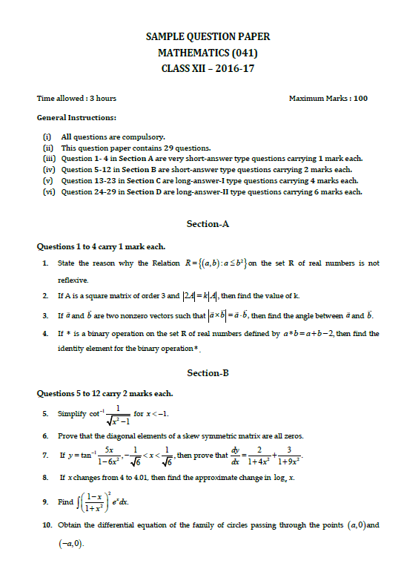
Sample Paper of Board Examination.
Page: 1

Slide 21
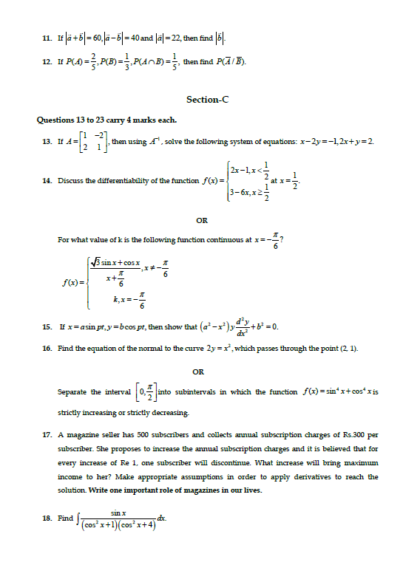
Sample Paper of Board Examination.
Page: 2

Slide 22
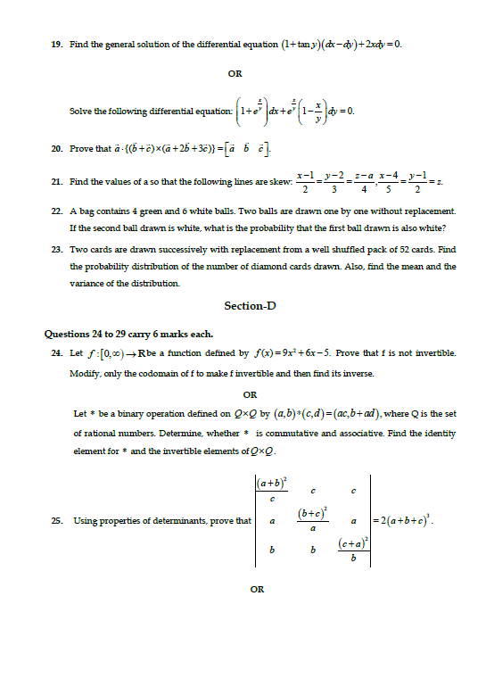
Sample Paper of Board Examination.
Page: 3

Slide 23
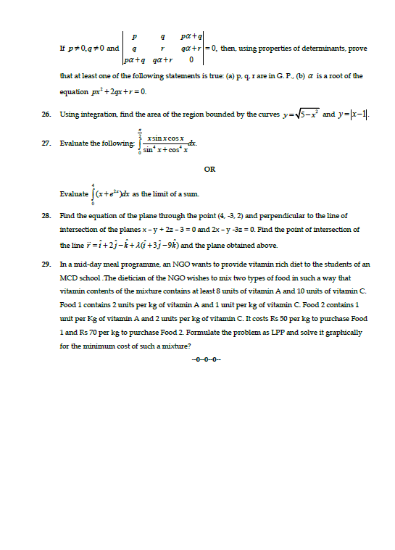
Sample Paper of Board Examination.
Page: 4

Slide 24

Any

Slide 25
τηανκ ψου

